Slide 1
Please read before using this template
Instruction
Which slides should I edit?
Slide 3: Who am I? (text + photo)
Slide 7: My own experience in Sweden (text, please keep the branded text color)
Slide 9: One University – Two Campuses (text)
Slide 13: Study in Sweden (text)
How do I know which text to edit?
The texts you need to edit are marked with highlight …… Please make sure to remove the highlight after you have added your texts.
Can I add additional content if I want to share something else?
Yes, as long as they fit in the main structure and match with the topics.

Slide 2
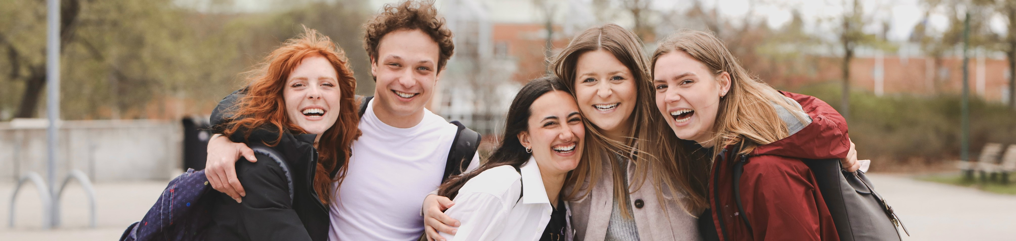
Study at Dalarna University
Photographer: Ulrika Lundholm Ericsson

Slide 3

My name is ……
Who am I?
I come from ……
In ……, I moved to Dalarna, Sweden to study ……
NOTE: Add your flag and ideally several symbols about your country, otherwise just write the name of your country here.
🧳🛫
🌲☕️🧆
❄🦌️⛄️
Notes:
On the left, please add a photo of yourself.

Slide 4

Sweden is equal, green and chill
About Sweden
Equal: Equal society, transparant, lack of hierarchy
Photo: https://studyinsweden.se/

Slide 5
Sweden is equal, green and chill
About Sweden
Equal: Equal society, transparant, lack of hierarchy
Green: Sustainable living and access to nature
Photo: https://studyinsweden.se/

Slide 6
Sweden is equal, green and chill
About Sweden
Equal: Equal society, transparant, lack of hierarchy
Green: Sustainable living and access to nature
Chill: Sweden is laid back, you can be yourself, there's space for everyone
Photo: https://studyinsweden.se/

Slide 7
For me, Sweden is …
My own experience in Sweden
Keyword 1
Keyword 2
Keyword 3
Notes:
You can choose to keep consistency with the keywords above. However, the key words can also be as simple as “friendship” “new experience” etc.

Slide 8
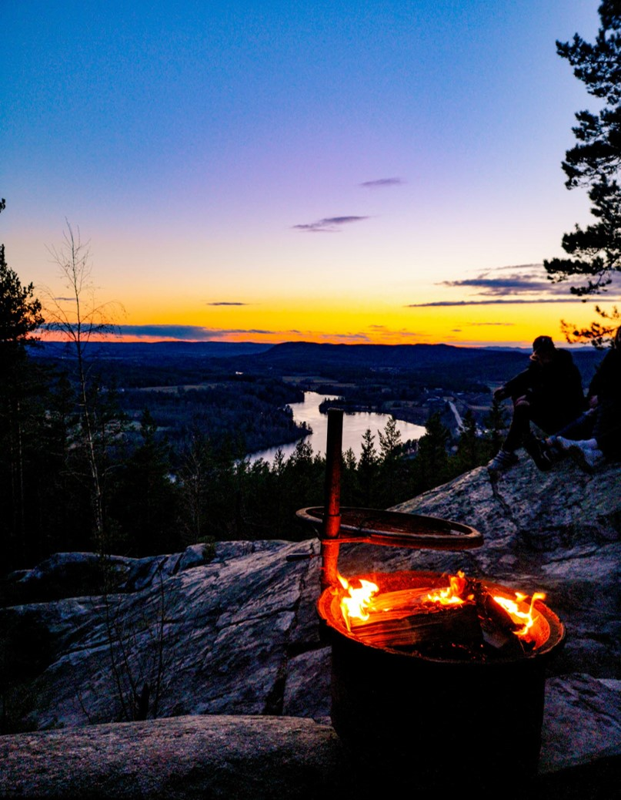
Dalarna is the heart of Sweden
Dalarna
2.5 hours to Stockholm (the capital city of Sweden).
“Traveling in Dalarna is like experiencing Sweden in a miniature.”
Dalarna is famous for well-preserved cultural heritage and amazing nature.
The hub of innovative business for companies such as SSAB, Hitachi, Clas Ohlson and Northvolt.
Photographer: Yasir Imam

Slide 9
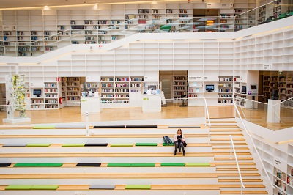
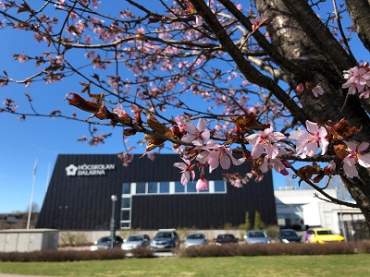
Dalarna University
One University – Two Campuses
Campus Falun
A modern university founded in 1977.
Two campuses in Falun and Borlänge (both are small towns).
New campus building in Borlänge in 2024.
10 International Master/Bachelor programmes.
Over 200 courses for exchange students.
I studied on campus ……
Campus Borlänge
Photographer: Yasir Imam, Xi Su

Slide 10

In the classroom
Study in Sweden
Informal classroom atmosphere with equality in focus.
Call teacher by the first name.
Seminars instead of lectures only.
Students are encouraged to discuss with the teacher.
Independence is expected.
Group work is the key.
Full-time study contains 40 hours per week, with 10-20 hours in the classroom.
Photographer: Ulrika Lundholm Ericsson
Notes:
Swedish society in general is informal and non-hierarchical. The teaching model at Swedish universities reflects "freedom with responsibility" and has equality in focus.

Slide 11
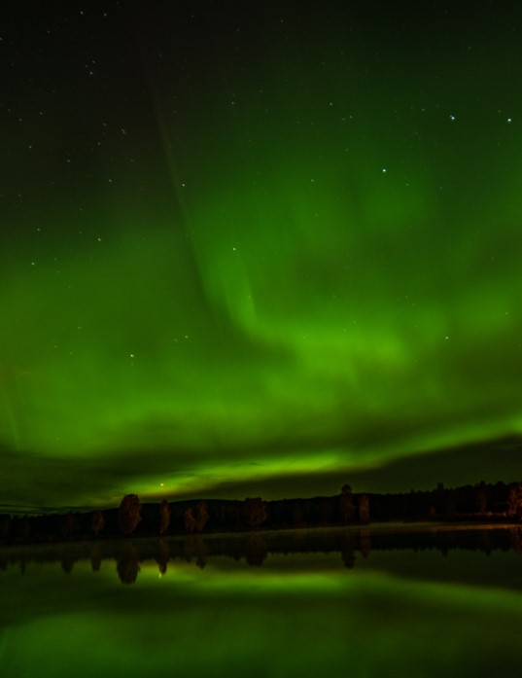
Life outside the university
Study in Sweden
Enjoy the amazing nature in Dalarna.
Go hiking and picking berries in the forest.
Swim in the lake.
Winter activities (ski, ice-skating and so on).
Hunt northern light!
Photographer: Fabian Gaukler

Slide 12
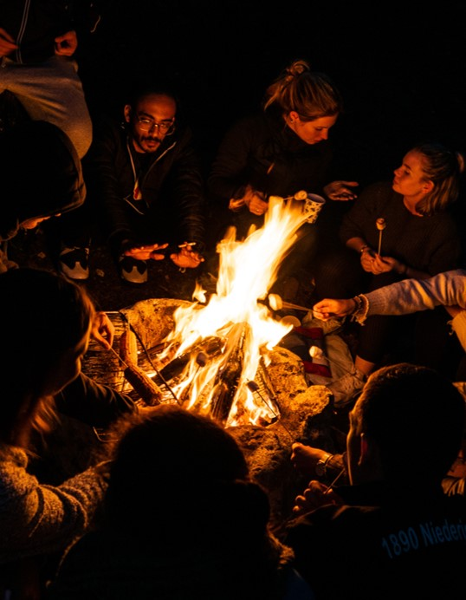
Life outside the university
Study in Sweden
Student housing is the best place to make new friends from all around the world.
Party (in student housing and at the student union).
Have potluck meals and Swedish fika with friends.
Join sports activities organised by the student union.
Photographer: Fabian Gaukler

Slide 13
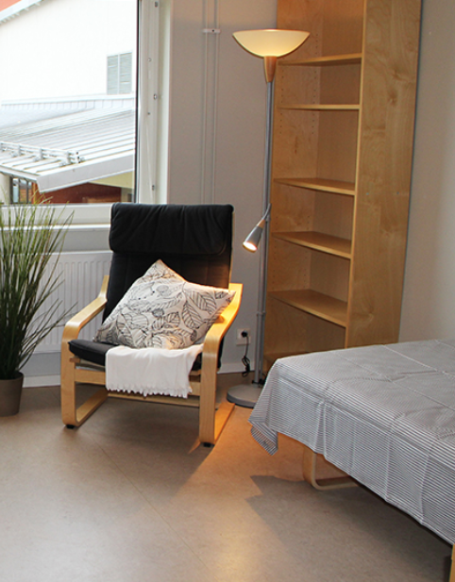
Cost of living
Study in Sweden
Students rent accommodation from local housing companies.
Corridor room with private bathroom or shared apartment are the most common types for student accommodation.
I had a budget of …… SEK per month when I lived in Dalarna.
Photo: https://student.tunabyggen.se/

Slide 14
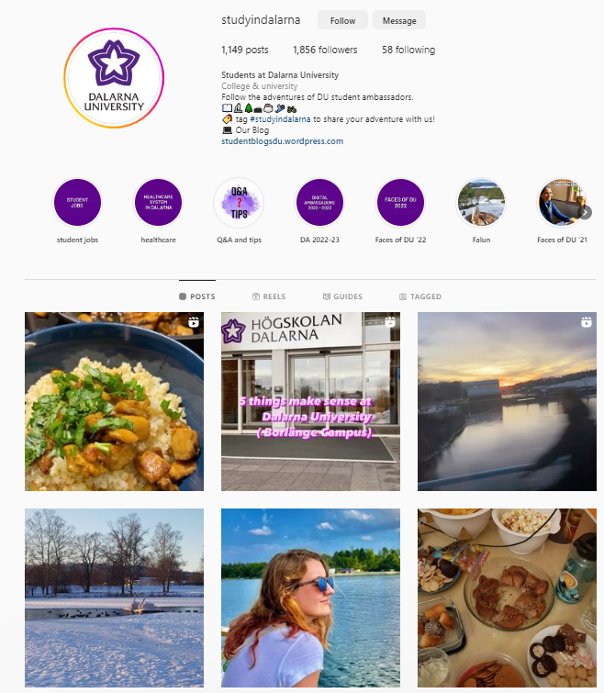
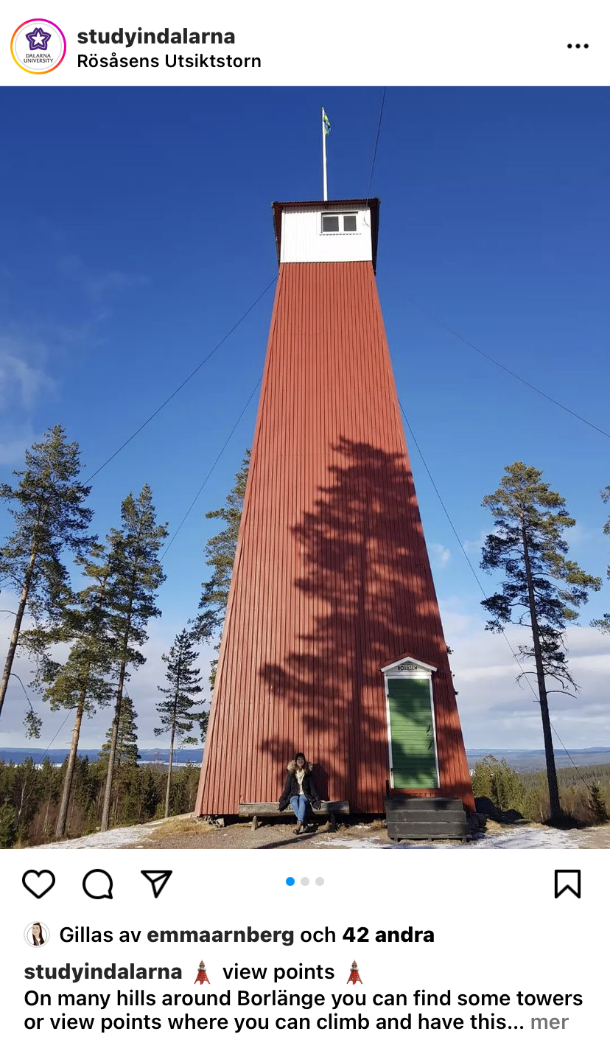

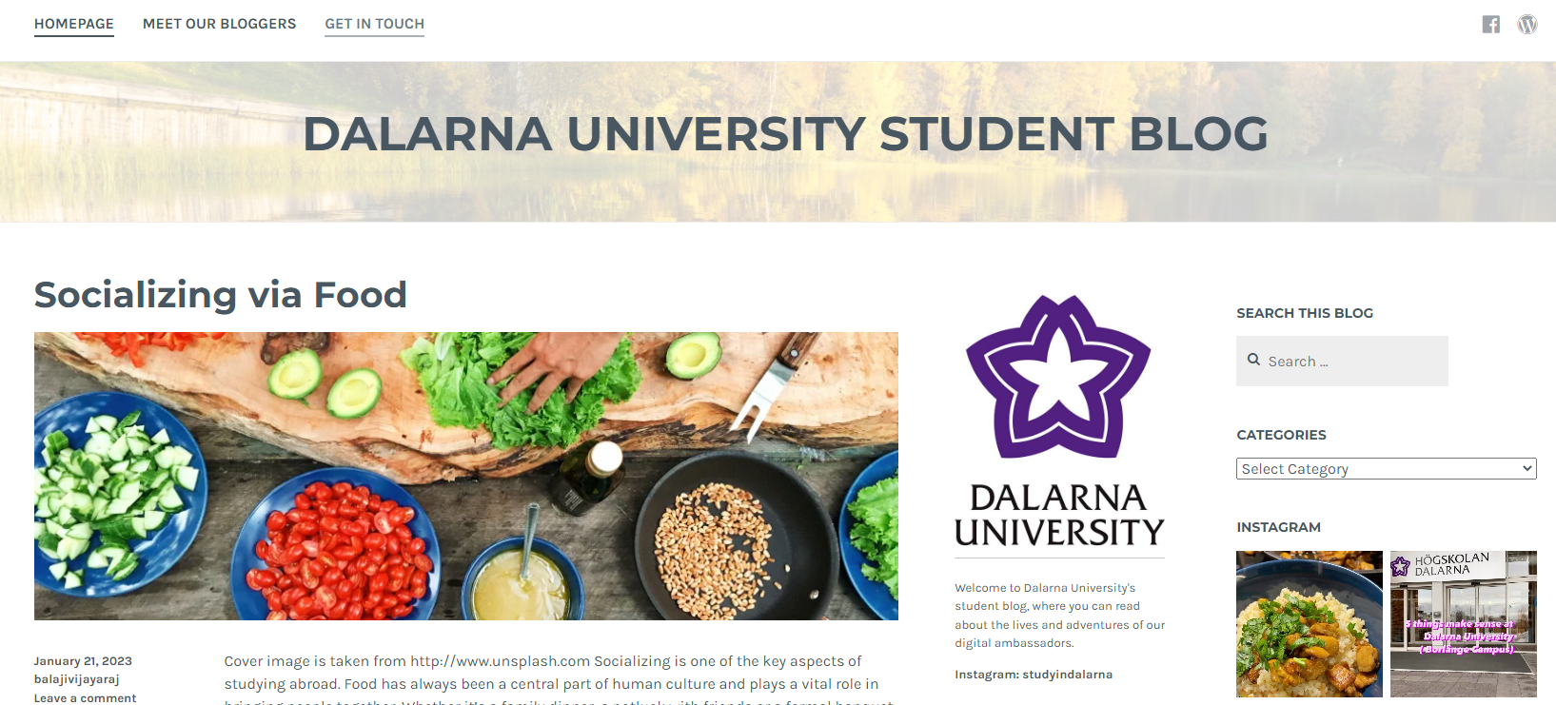
Have a question?
Contact Dalarna University
About courses/programme: www.du.se/studyatdu
About student life:
Instagram: studyindalarna
Blog: studentblogsdu.wordpress.com

Slide 15

Have a question?
Contact Dalarna University
Contact DU
Website: www.du.se
E-mail: support@du.se
Contact a student
Instagram: studyindalarna
Photographer: Ulrika Lundholm Ericsson

