Slide 1
Please read the instructions on this slide before you begin creating your PowerPoint.
Instructions
Which slides should I edit?
  Slide 3: My name is (text + photo)
  Slide 5: For me Sweden is (text, please keep the branded text colour)
  Slide 7: Dalarna University - One University, Two Campuses (text)
  Slide 11: Cost of Living (text)
How do I know which text to edit?
  The places in the text that you need to edit/write are highlighted in yellow.
  Be sure to remove the yellow highlight when you add your text.
Can I add content?
  Of course, but be sure it fits the main structure and matches the topics.

Slide 2
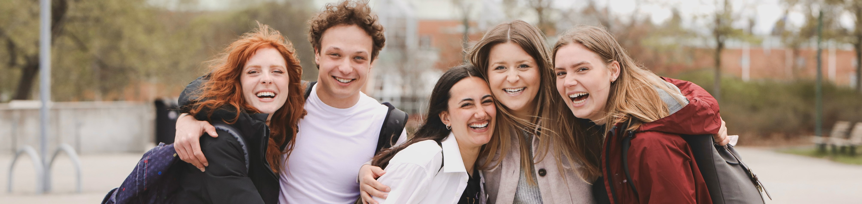
Study at Dalarna University
Photo: Ulrika Lundholm Ericsson

Slide 3

My name is ……
I come from ……
In Month/20xx, I moved to Dalarna, Sweden, to study xxx/take the programme titled xxxx.
NOTE: Add your flag and pictures that symbolise your country. You can also just write the name of your country here.
🧳🛫
🌲☕️🧆
❄🦌️⛄️
Notes:
On the left, please add a photo of yourself.

Slide 4

Sweden
Equal: Sweden is an equal society – transparent, no hierarchy
Green: Sweden works hard to address environmental challenges – sustainable living, access to the outdoors
Laid-back: Sweden is a laid-back place to live – you can be yourself, there’s a place for everyone
Photo: https://studyinsweden.se/

Slide 5
For me, Sweden is …
Keyword 1
Keyword 2
Keyword 3
Notes:
You can choose to keep consistency with the keywords above. However, the key words can also be as simple as “friendship” “new experience” etc.

Slide 6
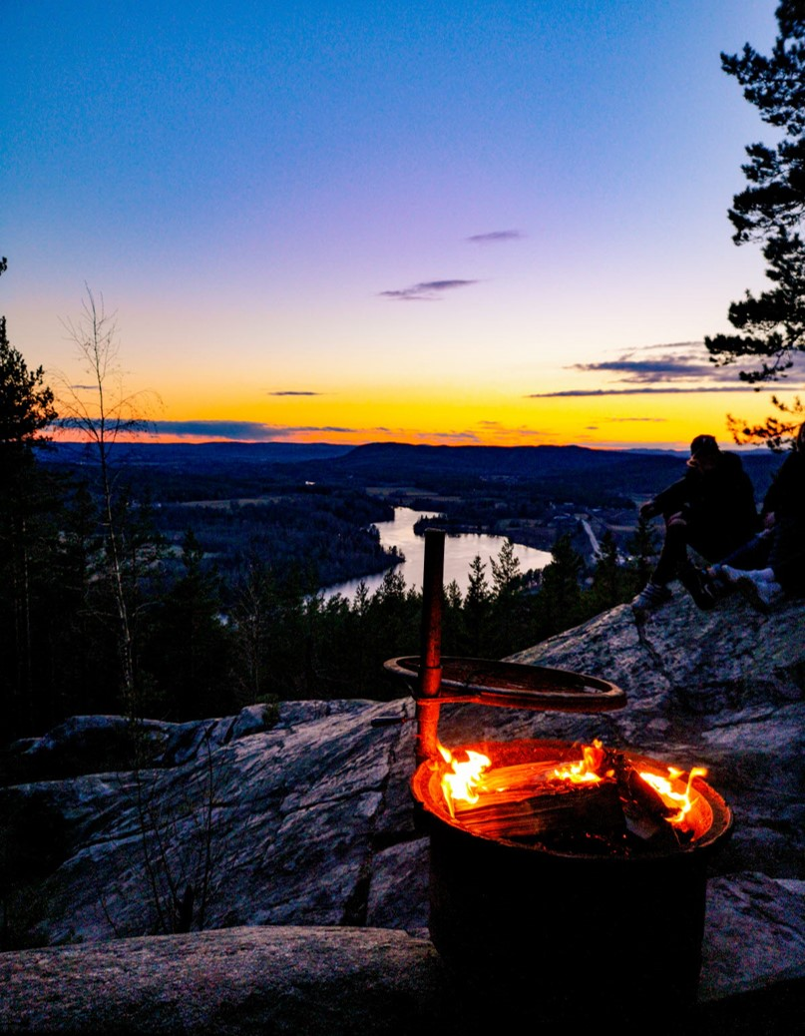
Dalarna – the Heart of Sweden
2.5 hours (train/car) to Stockholm (the capital city of Sweden).
“Travelling in Dalarna is like experiencing Sweden in miniature.”
Dalarna is well-known and loved for its cultural heritage and pristine nature.
The hub of innovative business for companies such as SSAB, Hitachi, Clas Ohlson, and Northvolt.
Photo: Yasir Imam

Slide 7
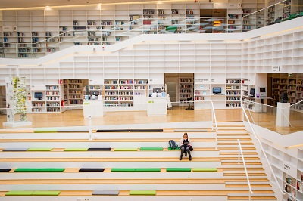
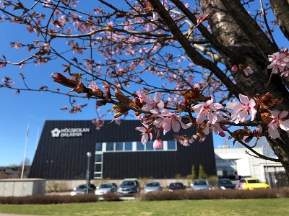
Dalarna University –
One University, Two Campuses
Campus Falun
Campus Borlänge and Campus Falun
Founded in 1977
New campus in Borlänge: completion in 2024
10 International Master’s/Bachelor’s programmes
Over 200 courses for exchange students
I studied at Campus ……
Campus Borlänge
Photos: Yasir Imam, Xi Su

Slide 8

In the Classroom
Informal classroom atmosphere with equality in focus
Call teachers by their first name
Seminars instead of only lectures
Discussion with teachers encouraged
Independence is expected
Importance of group work
Full-time study = 40 hours per week / 10-20 hours in the classroom
Photo: Ulrika Lundholm Ericsson
Notes:
Swedish society in general is informal and non-hierarchical. The teaching model at Swedish universities reflects "freedom with responsibility" and has equality in focus.

Slide 9
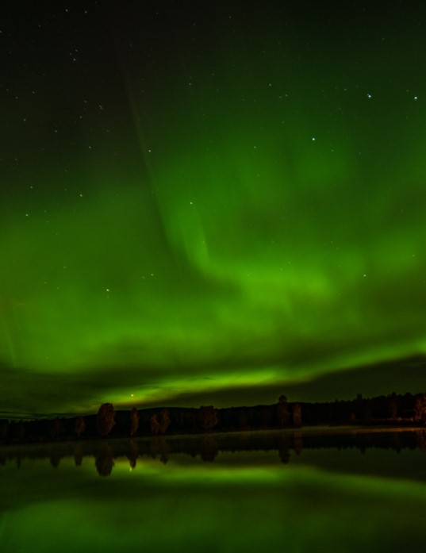
Life Outside the University
Enjoy the amazing natural surroundings.
Go hiking and pick berries in the forest.
Swim in lakes in the summer.
Skate on frozen lakes in the winter.
Ski on trails and down slopes (local ski centres).
Experience the magical Northern Lights.
Photo: Fabian Gaukler

Slide 10
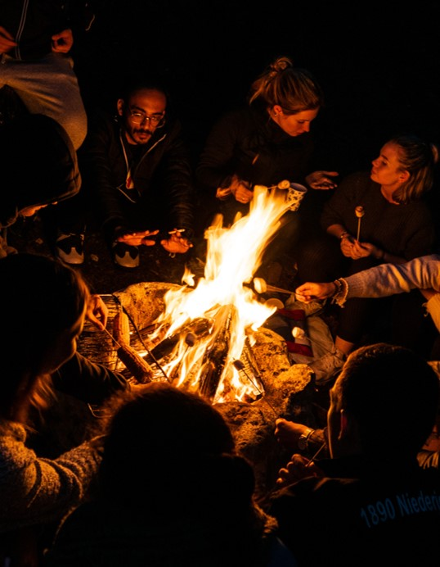
Social Life
Student housing – best place to make new friends from all around the world
Parties (in student housing/at the student union)
Potluck dinners and Swedish fika with friends
Sport activities organised by the student union
Visit Dalarna – ideas for activities
Photo: Fabian Gaukler

Slide 11
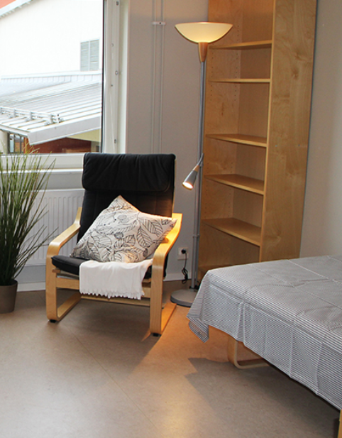
Cost of Living
Students rent accommodation from local housing companies
Corridor room with private bathroom and shared apartment – most common types of student accommodation
I had a budget of …… SEK per month when I lived in Dalarna.
Photo: https://student.tunabyggen.se/

Slide 12
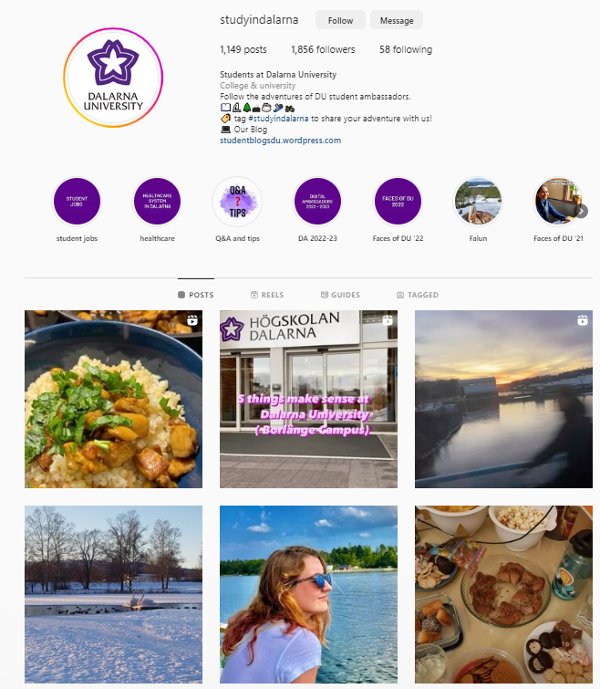
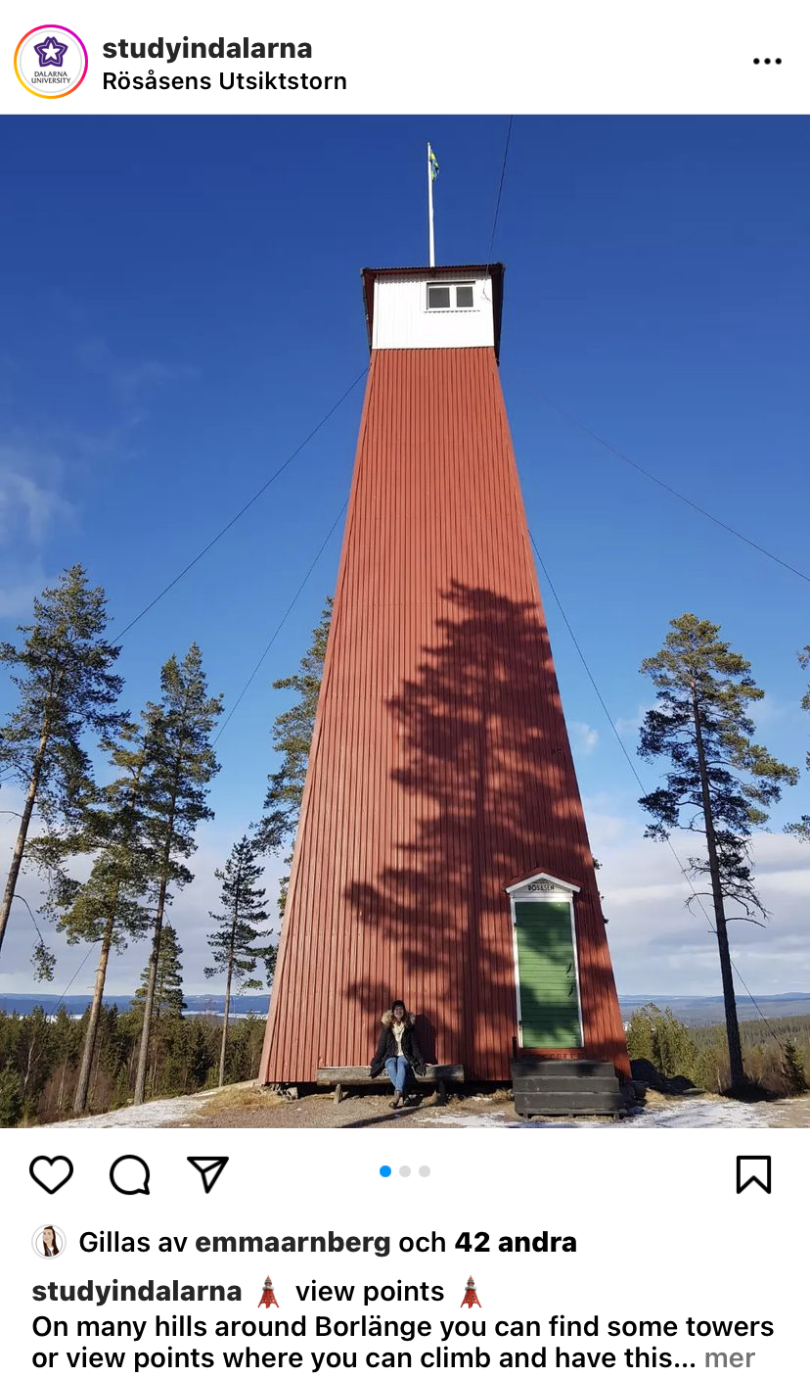

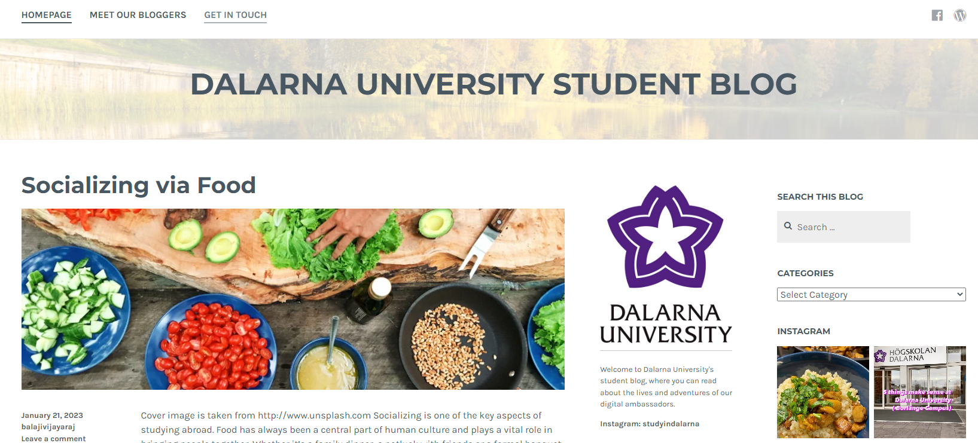
Questions?
About courses/programme:
www.du.se/studyatdu
About student life:
Instagram: studyindalarna
Blog: studentblogsdu.wordpress.com

Slide 13
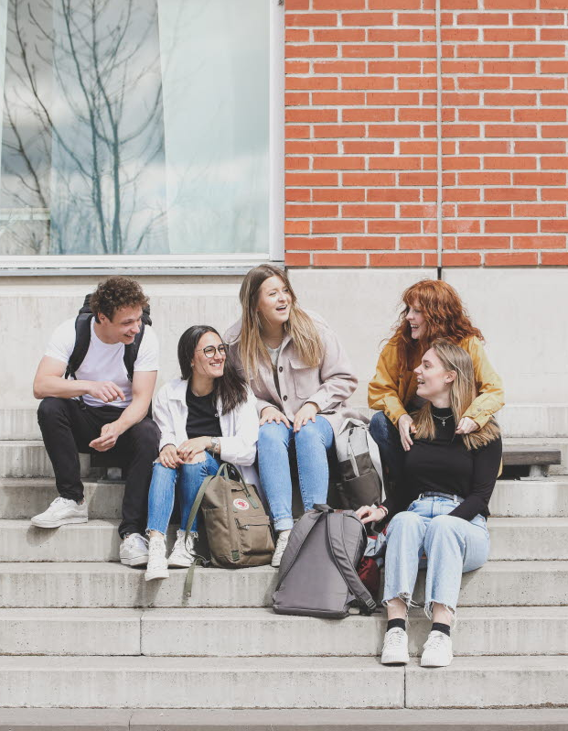
Questions?
Contact Dalarna University
Website: www.du.se
Email: support@du.se
Contact a Student
Instagram: studyindalarna
Photo: Ulrika Lundholm Ericsson

