Slide 1
Welcome Day New International Students, Spring 2026
Room B101 2026-01-16

Slide 2
About this presentation…
⏰ We’ll finish around 11:50
🚪 Emergency exits: left and right side of the room
Meeting point in the park outside the campus
🚻 Bathrooms: outside and to the left – use anytime

Slide 3
Today’s program
Welcome to Dalarna University
Winter week overview
Your new home: Falun & Borlänge
Student support & wellness
Life & studies in Sweden & DU
IT tools for DU students
About Lunch + afternoon program
The presentation (PPT) will be shared at www.du.se/WelcomeDay

Slide 4
Jörgen Elbe
Room B101 2026-01-16
Greetings from our Vice-Chancellor

Slide 5
Linus Kallin
Room B101 2026-01-16
Greetings from the Vice-chairperson, Student Union

Slide 6
Introduction Week Activities in Falun and Borlänge
A great chance to meet Swedish students and make new friends.

Slide 7


Slide 8
Time for a Quiz (with a prize!)
Take out your phone and go to kahoot.it

Slide 9

Niklas Sjögren
Student coordinator
Borlänge
Frida Ode
Student coordinator
Falun
Jacob Ode
Business coach
Dalarna Science Park
Notes:
Hi and welcome! So nice to see all of you here today! My name is Frida, and I work for Falun Municipality with questions related to education, entrepreneurship and work life.
I was in the very same position as you about 4 years ago when I also started studying at Dalarna University. Last year I did like some of you and took the opportunity to study abroad. I spent the spring in Taiwan, which was a great experience. So I can really relate to you guys, you probably have a lot of thoughts and questions about what’s it going to be like, and my best advice is just enjoy it and to make sure you take the opportunity to also explore Sweden, the culture, the people and the surroundings.
And my name is Niklas Sjögren, I work at the business department at Borlänge Municipality and we work very close together with the student union, the university, Dalarna Science Park and the municipal housing companies to give you a good time here. We are going to tell you a little bit about Falun, Borlänge and the activities we are organizing this semester. But first of all, Welcome to Borlänge and Falun!

Slide 10
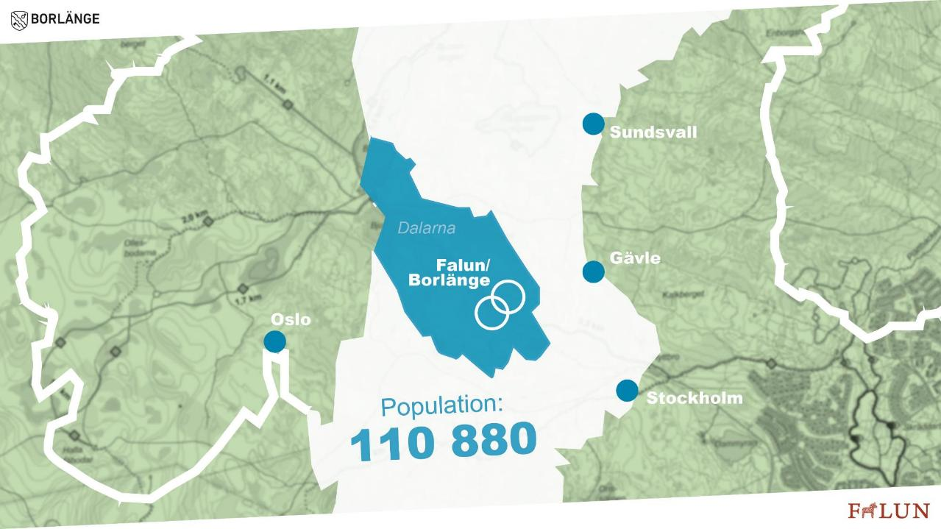

Population:
+110 000
Notes:
Borlänge and Falun are almost the same size as each other. About 55000 people live in each municipality and together we become a decent sized Swedish city.

Slide 11

Notes:
In just 20 minutes you reach Falun city centre from Borlänge city centre (or the other way around, of course.)
In many bigger cities that is what it takes to go to the next district. And remember, it is possible to walk or go by bike between if you want.

Slide 12







Notes:
As Niklas said earlier we want you to have a good time and be happy when you are here. There is actually a bunch of organisations that works together to make the most of your time while you are here. We are a part of a collaboration group and we have three main questions, that you have somewhere to live while you´re here, to make sure you´re time here outside of the studying will be good and of course to have good relations with the companies here if you want to stay and work here after you´re time at the Dalarna University.

Slide 13
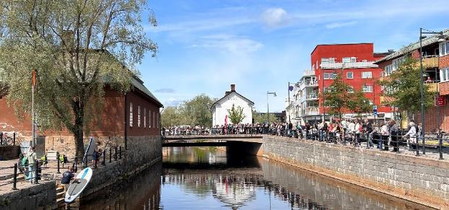
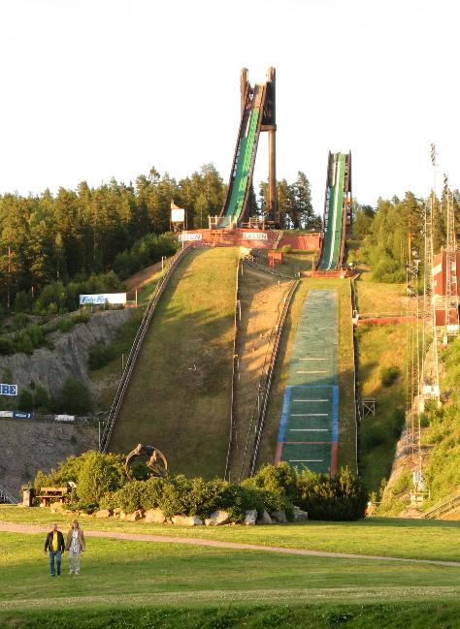

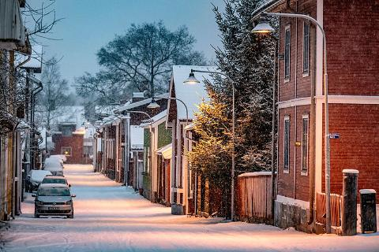
Notes:
15 min city, Sporty and outdoorsy, cafés and shops, Lugnet, Copper mine, Falu rödfärg. Now I will tell you a little bit about Falun, but it is just gonna be like a taster so please come and explore it yourself!
Falun is what we in Sweden call a 15 min city, it means you can get anywhere in the city within 15 min on a bike. The first thing I noticed (and bear in mind that I am Swedish) when first moving here was the sound of people doing roller skiing. Falun is full of sporty and outdoorsy people.
Even though it is a small town you have got all you need when it comes to shops, cafés, and restaurants right in the city center. And if you want to do more shopping or have more Music events you just go here to Borlänge. Or even down to STHLM, it is just about 2,5 hours by train.
Falun is specifically known for 3 things: Do you know what?? Anyone?? Lugnet, a sports and recreation area where you can practise about 70 different sports
Falun Coppermine a UNESCO world heritage you just have to visit while being here we are not a city full of feminist it is the symbol of Copper.
Falu Rödfärg - the red house color, that you find all across Sweden its origins from Falun and is actually made from residual products from the mining. And of course, we also have several old areas with those red wooden houses otherwise it wouldn’t be Sweden, right?! What is this symbol representing? Yes Female and Copper. Lots of buildings in Falun have this on the wall or on the roof, and walls it is from representing the Copper mine city.

Slide 14
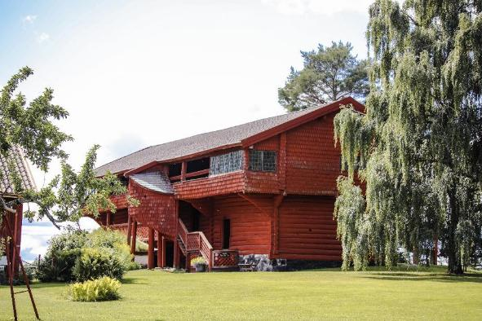
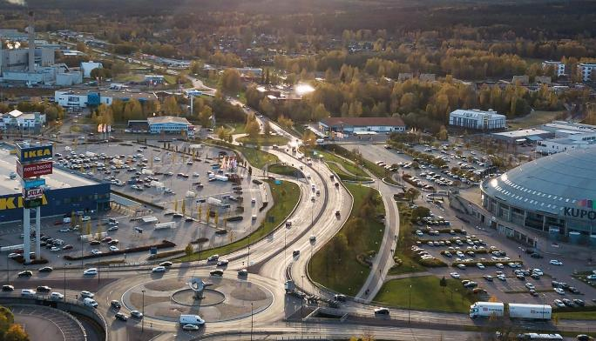

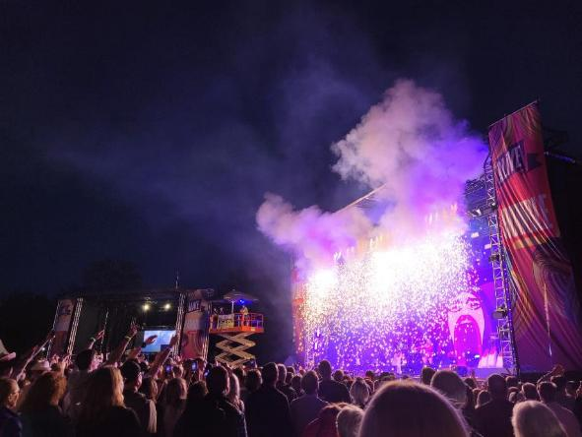
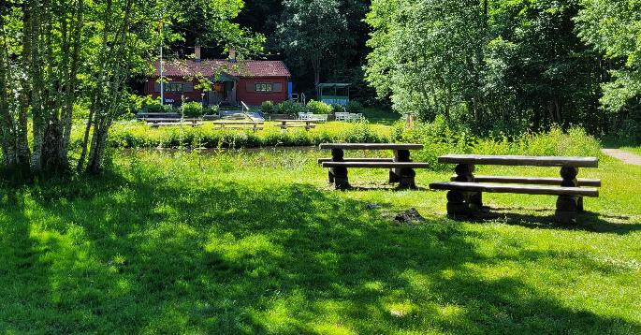
Notes:
Borlänge is Sweden´s smallest metropolis and means live long time, and I sure hope that many of you will do that. Except a modern campus the city center consists mostly of restaurants, cafés and offices, but of course there are also some shops.
The architecture is characterized by 1960s, when Borlänge was referred to as Sweden´s most modern city. Sweden´s first funky department store is this building we are in right now.
A big reason why we don´t have so many shops in the center is because we were early to build an external shopping area, which is very common in Sweden today. What is unique in Borlänge is that the external shopping areas are so close to the city as they are.
In Borlänge, there is both history, culture and sports to explore. IK Brage play in sweden´s second highest football series and there are many other teams as well, both to watch and play in if you want to do it. In additions to football, it is possible to practise many other sports as well, both team and individual.
For those of you that are interested in history, there is a lot to see and for you who like culture, Borlänge is a music city where we have some restaurants who arranged conserts all year around. If you live here long enough to stay over the summer, I hope you want to visit the music festival Alive, that is on in the first week of July.

Slide 15
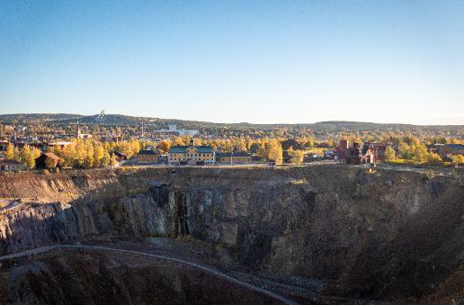
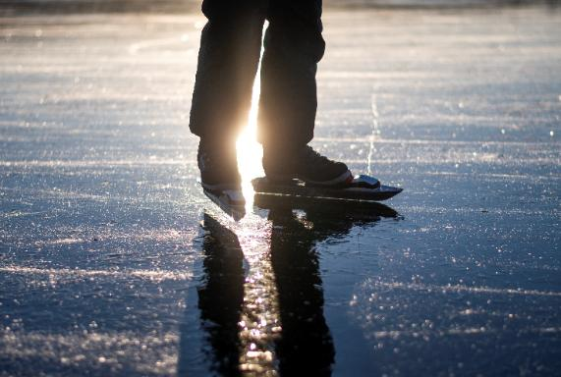
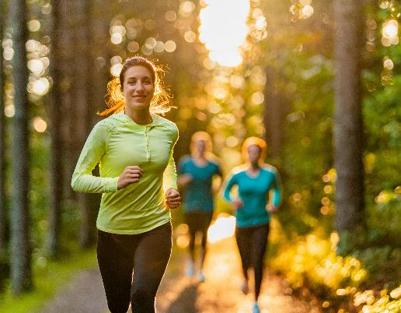
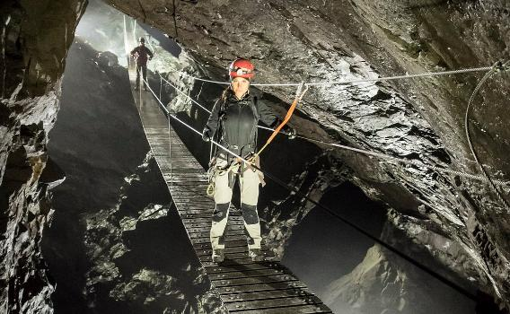
Notes:
As mentioned previously, we have arranged a variety of activities for you, and we really hope you will join us in exploring what Sweden has to offer. Among the events we have planned is:
14/2 En dag på isen
7/3 Falu gruva
28/3 Äventyrsgruvan
5/5 Högskoleloppet
Where do I find information about what’s is going on?

Slide 16

Activities spring 2026
-Winter week
-A day on the ice
-Falu copper mine
-Adveture mine
-University walk and run
Sign up in the Orbi app!

Slide 17

Notes:
Frida 2/2 AW kommuninformation
9/2 AW Swedish culture
16/2 AW New in Sweden
5/3 Jobs and career

Slide 18
Activities spring 2026
-Your new hometown
-New in Sweden
-CV Workshop
-More activities coming during the semester
Sign up in the Orbi app!

Slide 19
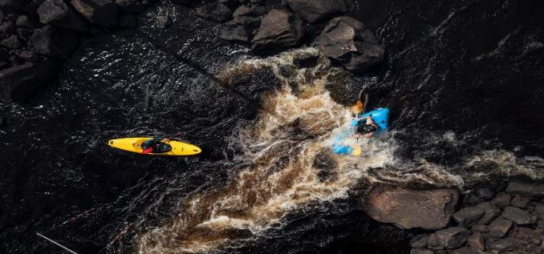
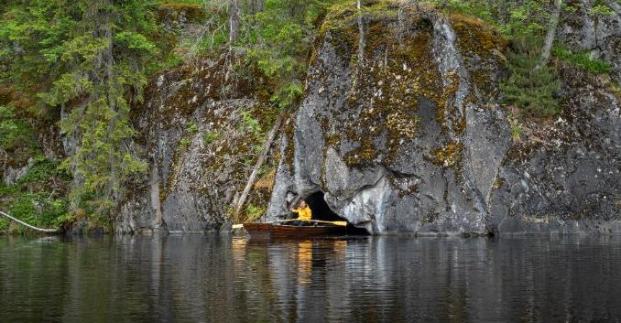
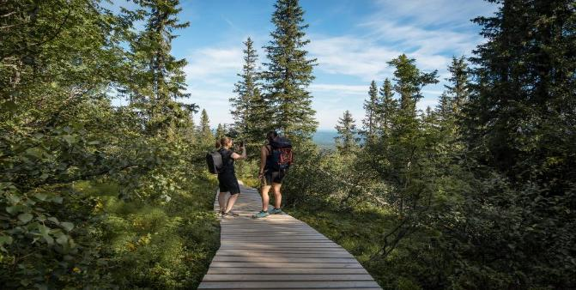
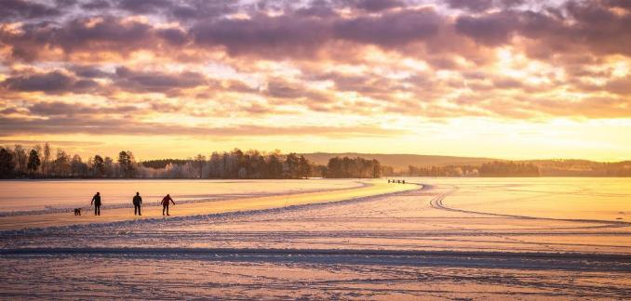
Discover Dalarna
Notes:
Dalarna are like a Sweden in miniature and a lot of Swedish history and culture take place here. We hope that you will take the opportunity to discover Dalarna during you´re time here.

Slide 20
www.visitdalarna.se/en
Notes:
www.visitdalarna.se/en That sounds awesome but if I just want to go for a hike in the neighborhood (or somewhere else in the nature) where do I find info about that?

Slide 21

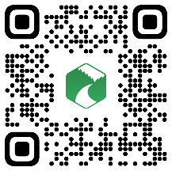
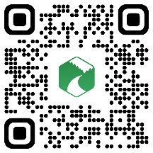










Naturkartan
Android
Apple
Notes:
The Naturkartan app is a help to find trails and places to go and is also a help for you to navigate while you´re hiking. We sincerely hope that we will not have to read in the news about international students who have gotten lost in the forest.

Slide 22

Notes:
Fritidsbanken - Niklas

Slide 23
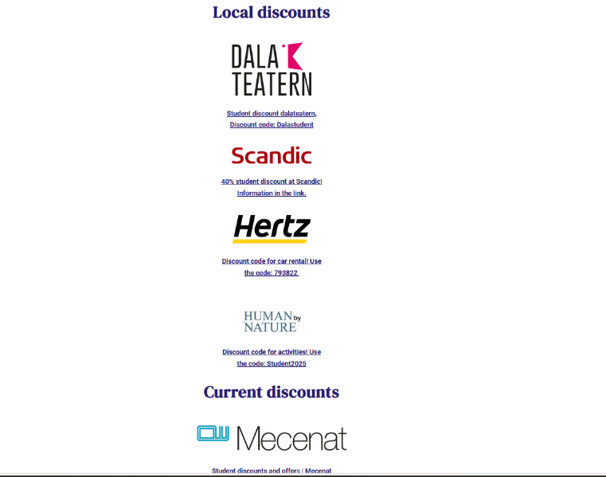
https://www.dalastudent.se/en/rabatter/
Notes:
Discount code: 793822

Slide 24
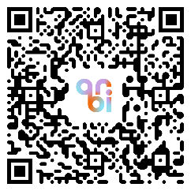
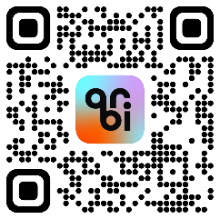
www.dalastudent.se
Android
Apple
Notes:
And remember this website and to download Orbi

Slide 25

Notes:
We hope that you will have a great time here in Sweden and remember that you can always contact us if you have any questions.
Welcome Home!

Slide 26
Group activity
Find (at least) three things you have in common with each other
Notes:
split into groups of approximately 5-6 people by where they are sitting and should try to find at least 3 things they have in common. Simple things like “don’t speak Swedish” or “Never been to Sweden before” should be avoided. After groups have had about 8 minutes to talk volunteers can be asked to say what they have in common (use microphones). Not all groups need to/should answer due to time constraints

Slide 27
Service Center
Sara Markstedt, Support Staff
Notes:
Hello everyone, my name is Sara Markstedt and I work as Support Staff at Dalarna University’s Service Center. I’m working both in Falun and Borlänge.

Slide 28

Do you have questions?
support@du.se
Notes:
If you have any question you can send an e-mail to support@du.se 24 seven.
Many of you may already have done this, and gotten a response from either me or any of my colleagues.

Slide 29

That looks suspicious…
Don’t worry, your e-mail will not disappear into a black hole!
Normally you will get an answer within 48 hours (weekdays)
Notes:
Incoming emails are handled by our first line which consists of myself and my colleagues in Falun and Borlänge. You might have seen us in the reception already. We answer the questions we are able to, or make sure that your question reaches the right person or department who in turn will get back to you.
Please send a new request if you have another question later on, do not respond to a previous conversation.

Slide 30
We monitor the inbox for support@du.se
Notes:
You may have already spoken to some of us. We handle incoming calls to the university’s switchboard and support phone, so chances are we’ve already talked.
You’re always welcome to visit us at the reception in Falun or Borlänge.
We’re here to help in person too.

Slide 31
What type of questions?
Registration
User account
Canvas
Zoom
Examinations
Credit transfer
IT
Degree questions
Study- and career counselling
Printing
Tuition fees
Insurance
Leave from studies
Pretty much anything!
We are here to help!
All we ask is that you try to be as
specific as possible in your request

Slide 32

Support Café in Zoom
Meeting ID 9023778888
Opening hours
Monday – Friday 8 am – 4 pm
Closed Tuesday 9 am – 10 am
Notes:
We also have a support cafe in zoom where you can share your screen and they can help you with your questions, mainly about zoom or canvas.
The meeting ID is 9023778888 or you can find it on the studentweb as well
Opening hours are between 8 am and 4 pm Monday to Friday. Except on Tuesdays when they are closed between 9 am and 10 am.

Slide 33
Student Health Services

Slide 34
Support during your studies
Student Counsellors
University Chaplain Student Health Services
Disability Coordinators
Study and Career Counsellors
Click on ”Services and Tools” at www.du.se/en/student-web
Or email:
support@du.se

Slide 35
Time for a power-break
Stand up and stretch!

Slide 36
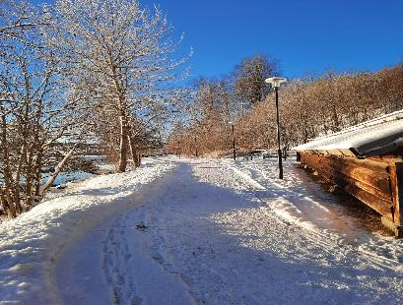
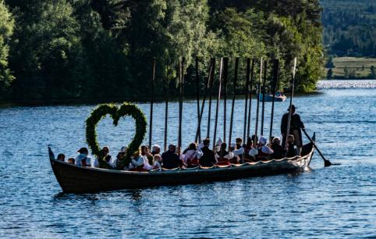
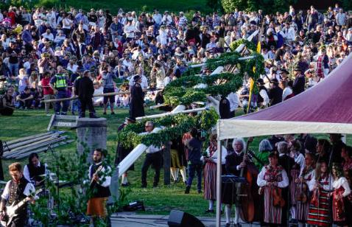
Welcome to Dalarna
Fotograf: Ulrika Lundholm Ericsson
Susanne Corrigox, Coordinator of International Affairs
Notes:
County of Dalarna is the traditional and cultural cradle, situated in the heart of Sweden. Here you find a mix of art, dance and music, fantastic surroundings, and big international companies (Sweden Steel and Hitachi).
Outdoor activities and sports are the things to do here!

Slide 37
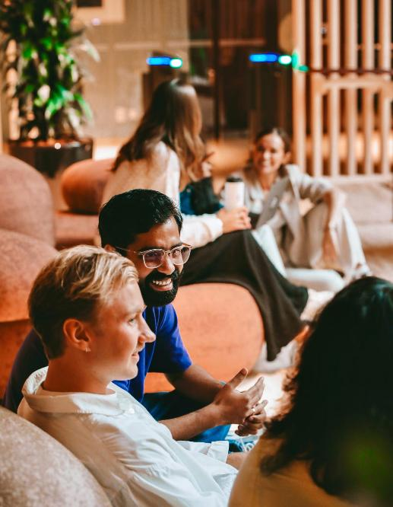
Welcome to Dalarna University!
About us
Established in 1977, young and innovative
Two campus
17000 + students, 81 % web–based students
300 incoming exchange students
12 different languages, excellent lab facilities
Fotograf: Ulrika Lundholm Ericsson
Notes:
Innovative
20 km distance, new campus Borlänge 2024
Netbased studies for more than 15 years
Research labs for professional athletes
Media House: Audiovisual Studies (film, sound, script writing)

Slide 38
About this Presentation
Welcome to Dalarna University!
Sweden – the basics
Living the Swedish Way
Studying in Dalarna
Fotograf: Ulrika Lundholm Ericsson

Slide 39
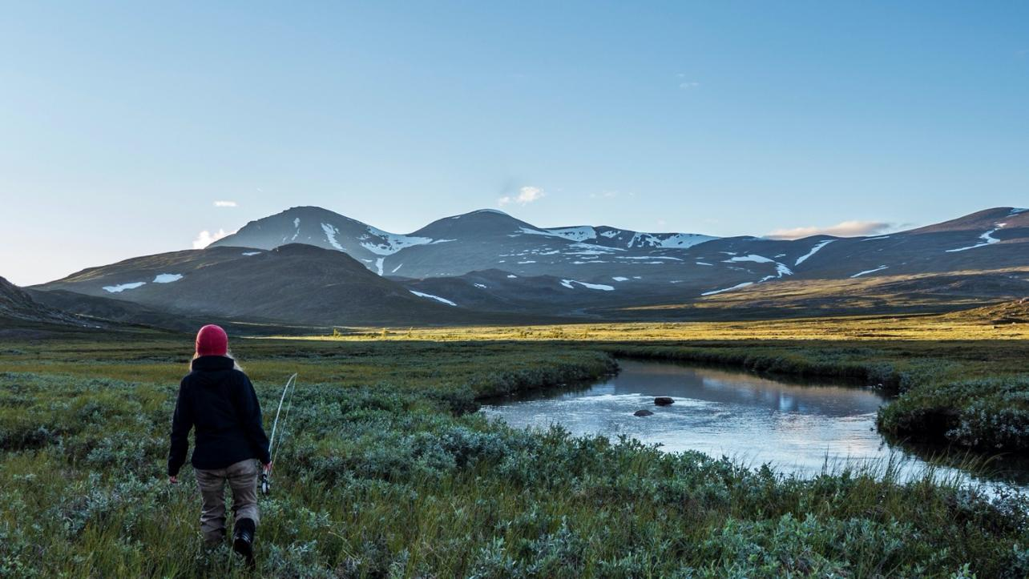

Sweden – just the basics
1
Photo: Stefan Ågren/imagebank.sweden.se
Notes:
Sweden is a fantastic place to study and work in, let’s start by talking a bit about Sweden and how it is to live there.

Slide 40
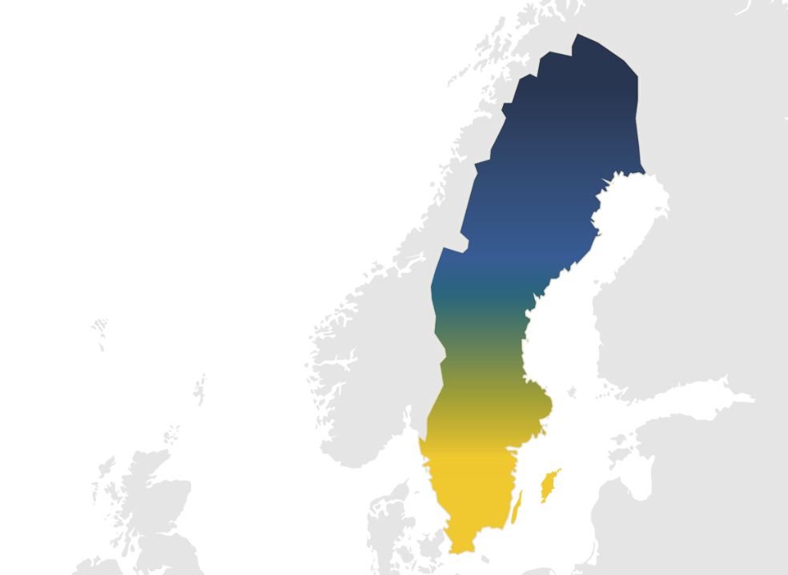
Sweden
million humans
10,5
nature reserves
5 000
100 000
lakes
Notes:
Sweden is a long, around 1600 km´s , narrow country in Northern Europe, right next to Norway, Finland, and Denmark.
There are more than 5,000 nature reserves here. That means plenty of space where you can hike, swim, and ski. So if you’re into the outdoors, Sweden might be a great fit.
Our population might be small, but our higher education system is known for being one of the best in the world.

Slide 41
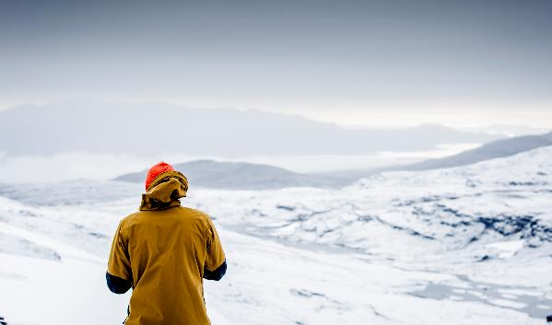
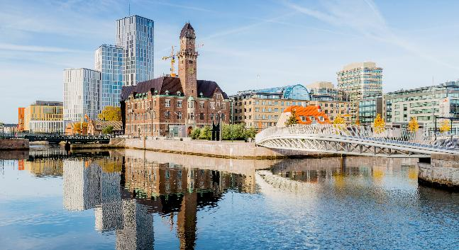
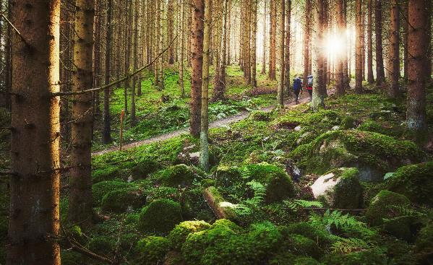
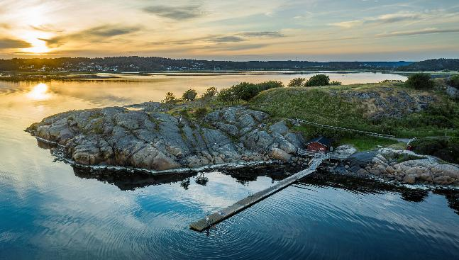
Carl-Johan Utsi/imagebank.sweden.se
Werner Nystrand/imagebank.sweden.se
Patrik Svedberg/imagebank.sweden.se
Per Pixel Petersson/imagebank.sweden.se
Notes:
Sweden’s nature is quite varied depending on where you are. From high mountains up in the north to endless forests throughout the country, and in the south, you’ll find rolling countryside and open fields. The nature is accessible for everyone (Right to Public Access - Allemansrätt ) camp in a tent 2 nights.
And then there’s the water. Sweden is home to nearly 100,000 lakes and a coastline that stretches for miles. In summer, that means swimming, kayaking, or just chilling by the water. And in winter – skating or even walking on frozen lakes if the conditions are right.
We also get four distinct seasons here. We’ve got everything from colourful autumns to the midnight sun in the far north. Summer can be warm and sunny – around 25 degrees Celsius. Winter, especially up north, can go well below -20. The cold isn't the worst thing, it's the darkness – that is the reason Swedes love to light different types of candles in the winter

Slide 42
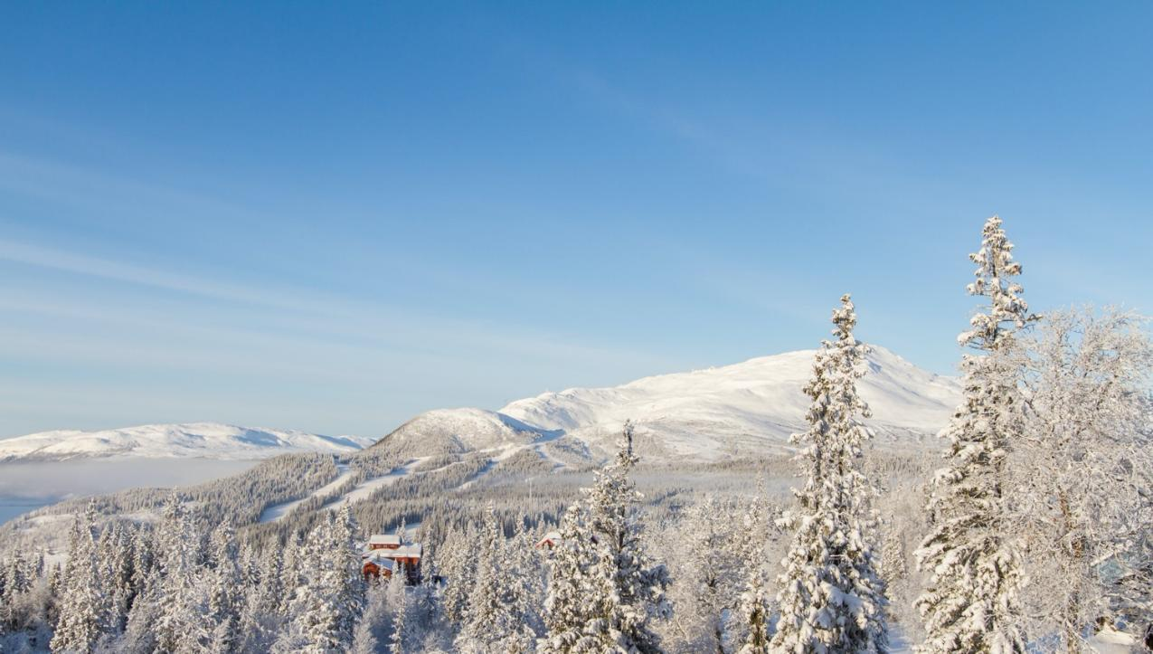
Living
The
Swedish
Way
2
Photo: Niclas Vestefjell/imagebank.sweden.se
Notes:
So, now that you have an idea about what the country looks like. What is it like to live in Sweden as an international student? The lifestyle here is quite unique.

Slide 43
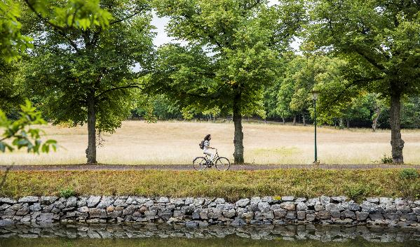
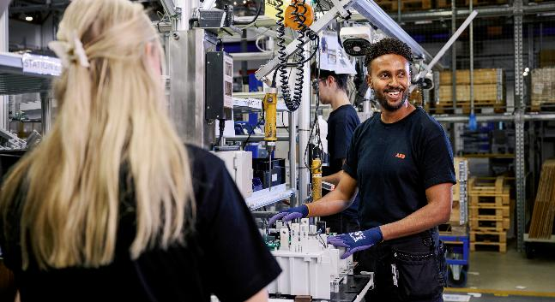


Notes:
Sweden is a secular democracy – open, progressive, and inclusive. Here, you can live life the way you want. It’s safe. It’s clean. It’s organised.
You’ll breathe fresh air. You’ll drink water straight from the tap. You’ll bike pretty much anywhere – in cities big and small.
We have a highly developed social welfare system. Healthcare is high quality and accessible. Parental leave is generous. Work-life balance actually means something here.
And when it comes to innovation, Sweden leads the way. Spotify, Volvo, Ericsson – all started here. We’re a global hub for green tech and sustainability.
Plus, there’s a rich cultural life – from music, film and design to traditions like fika and Midsummer. So whether you’re into museums, nature, street food, or second-hand shopping – you’ll find your place.

Slide 44







Equal – regardless of gender
11/24
1 year
government ministers are women
of paid parental leave – 3 months reserved for each parent
#1
98%
on the European Union Gender Equality Index
of Swedes feel promoting gender equality is important for a fair society
Notes:
Equality is a cornerstone of Swedish society. Regardless of gender, everyone is treated equally here – and it shows. Sweden ranks among the most equal countries in the world. We’re number one in the EU Gender Equality Index.
98% of people in Sweden believe gender equality is essential for a fair society.
Statistics (updated March24):
Government: https://www.statista.com/statistics/1279301/sweden-number-ministers-government-gender/
Gender Equality Index: https://eige.europa.eu/gender-equality-index/2023/country/SE
Perantal leave: https://www.forsakringskassan.se/english/parents/when-the-child-is-born/parental-benefit
Promoting gender equality:https://sweden.se/life/equality/gender-equality
Sweden is ranked nr 5 on the World Economic Forum Global Gender Gap Report 2023:https://www.weforum.org/publications/global-gender-gap-report-2023/in-full/benchmarking-gender-gaps-2023/

Slide 45
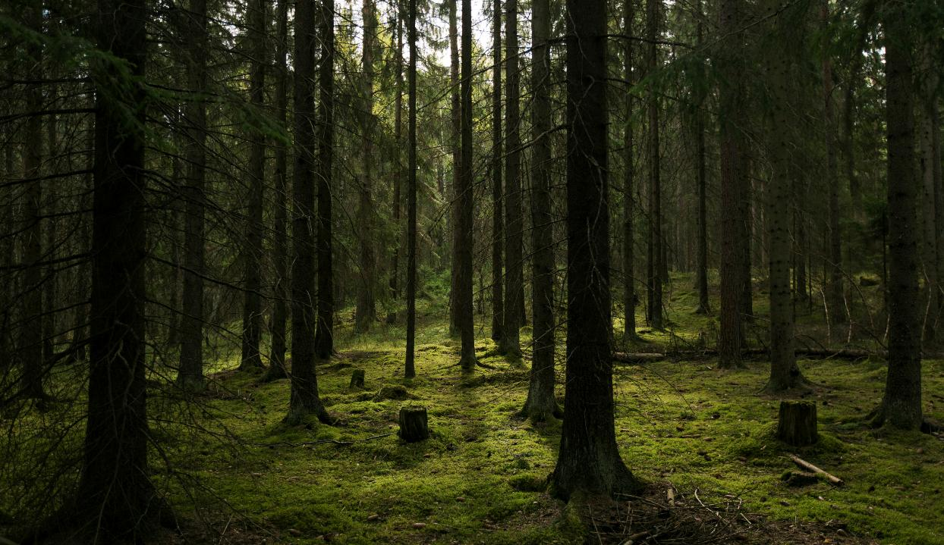




Green all the way
98%
9%
of our household waste in Sweden is recycled
of Sweden is covered by lakes and rivers
63%
60%
of Sweden is covered by forest
of the energy in Sweden is renewable
Notes:
Sustainability is another important aspect of life in Sweden. It is a part of how we eat, how to travel, and what to buy. From second-hand shopping and plant-based diets to electric buses and circular design.
Sweden is one of the world leaders in recycling. In fact, nearly 98% of household waste is recycled or used to generate energy. Sorting your waste is second nature here – we even recycle our food scraps.
When it comes to energy, Sweden is all about renewables. Over half of our energy comes from renewable sources like hydropower, wind, and bioenergy. Clean energy isn’t just a goal – it’s the standard.
Statistics (updated March 24):
99% recycled: https://www.avfallsverige.se/media/2vsjfl4c/svensk_avfallshantering_2022_kort.pdf
In 2022 more than 60% of Sweden’s electricity came from renewable energy: https://sweden.se/climate/sustainability/energy-use-in-sweden
9% of Sweden is covered by lakes and rivers: https://sweden.se/life/society/key-facts-about-sweden
63% of Sweden is covered by forest: https://sweden.se/life/society/key-facts-about-sweden

Slide 46

LGBTQIA+ in Sweden 🌈
I knew I was headed to a country where I could continue living openly and authentically as a proud member of the LGBTQ+ community.”
Max, Canada
Notes:
In Sweden, equality isn’t just about gender – it extends to sexual orientation and identity too. Everyone should be free to live and love openly, that’s something we’re proud of. And something we believe in deeply.

Slide 47
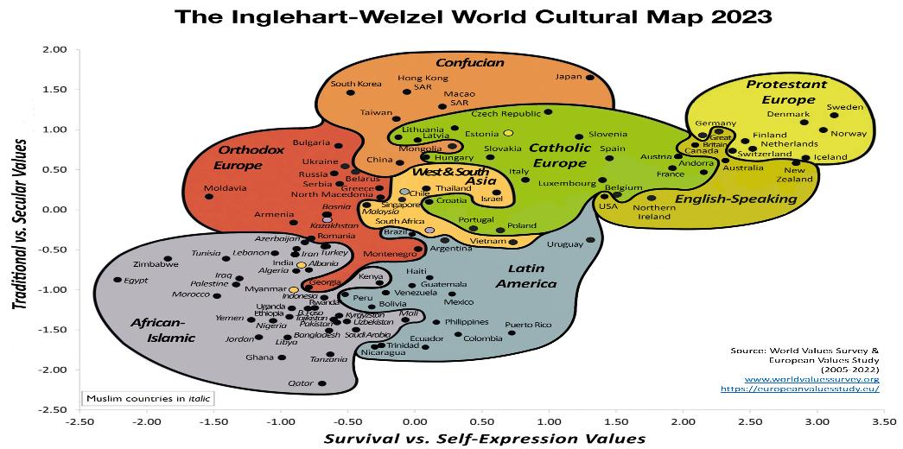

This is Sweden

Slide 48
Classrooms the Swedish Way
Studying in Dalarna
English is all you need – but you are so welcome to learn some Swedish☺
Focus on learning – not punishing failure
First names only – no titles here!
Question everything!
Fotograf: Ulrika Lundholm Ericsson
Notes:
The Swedish classroom focuses on the learning process and places a lot of responsibility on you for your learning. You’ll learn to develop your own thoughts and reflections, and you’ll focus on the quality of what you learn and what you produce. And if you fail? Well, that’s OK too. It’s an important part of learning and success. And the Swedish classroom culture recognises that.
In Sweden, you call your teacher by their first name. Sure, it might feel strange at first. But you’ll get used to it. And you’ll love the informality and sense of equality that exists in the Swedish classroom, that allows for a free and open way of working.
Rather than being fed information and expected to memorise it, you’re encouraged to ask critical questions in the classroom. You’ll be encouraged to think for yourself, question what is said and speak up.
We strongly believe that this helps you become an independent critical thinker

Slide 49
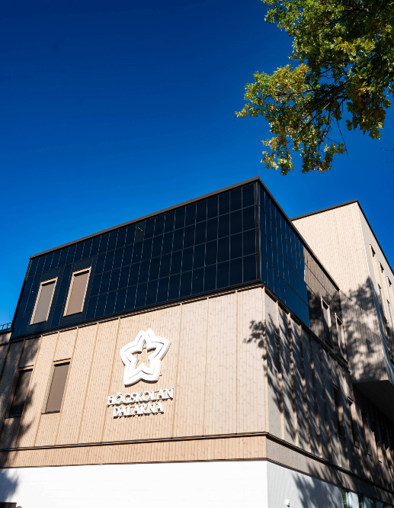
You are insured!
Good to Know!
All registered students are covered for personal injuries, both on campus and when you commute to and from campus.
If you need to visit a doctor, another insurance applies, StudentIN
Students who are not covered by the EU Health Card
The Student IN insurance covers emergency medical and dental care (up to a maximum cost of 3000 SEK)
du.se/insurance support@du.se
Fotograf: Linnea Hinz
Notes:
EU-citizens:
Bring the European Health Card when you visit a health clinic. You may ask for reimbursement of paid fees and costs for prescribed medicine.
In addition
Assault
Disability and death, home transport if needed
Loss of property
Liability and legal costs
Valid 24/7 in Sweden

Slide 50
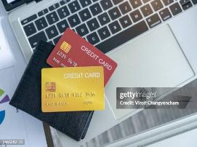
Bank Accounts
Cash is not King!
Swedish banks require extensive information to open an account.
Most banks require you to book an appointment before submitting your paperwork.
Expect the process to open an account to take many weeks
If you want to open a bank account, you need to present:
Passport /ID
A valid residence permit (non-EU only)
University Admission Letter and Proof of Registration
Personnummer/Samordningsnummer*
Notes:
Do you need a Swedish bank account?
"For those of you who want more information about applying for either a personnummer or coordination number, please join the session at the end of the day in room xxx)
Också viktigt att förklara att de flesta människor har kontakt med sina banker digitalt, men om du har personnr finns flera möjligheter att öppna ett konto via banker som har ett fysiskt kontor i Sverige.

Slide 51
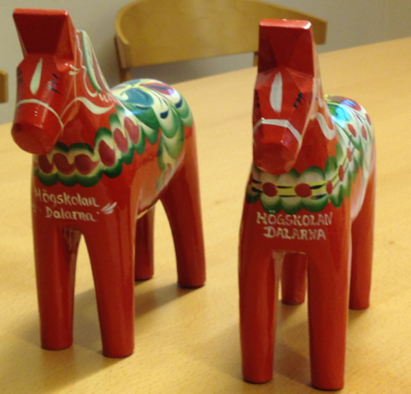

Thank You for Your Attention!
Stay safe and have fun!

Slide 52
Time for a Quiz!
Take out your phone and go to kahoot.it

Slide 53
IT tools for DU students
Michael Oppenheimer

Slide 54
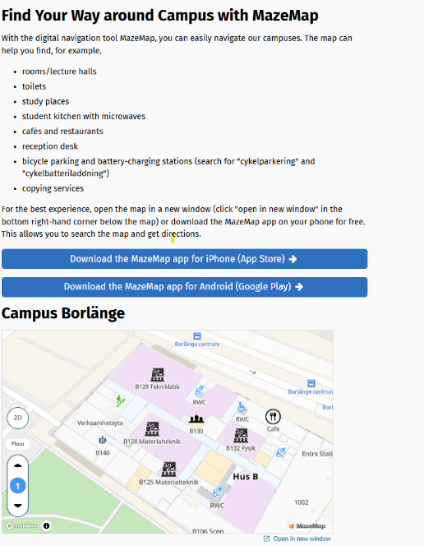
Mazemap – find your way
Download the MazeMapp app to quickly find your way around our campuses.

Slide 55
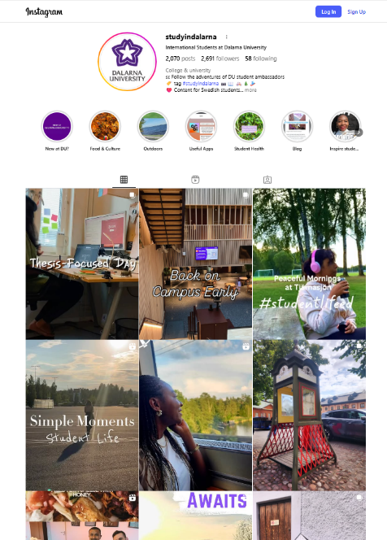
Student perspectives
Instagram – Studyindalarna
https://www.instagram.com/studyindalarna/
Notes:
-This isn’t anymore about IT tools but I also highly encourage you to visit the student run Social Medica accounts that we have. The IG account of Study in Dalarna is run by our wonderful Digital Ambassadors. Here you can find really fun stories, experiences and useful tips as a student. It covers both academic and non-academic topics, so it really helps you navigate student life here. Some of you may have even been inspired to apply here because of the posts!
-Just to plug this in. For those who are Social Media savvy or just wish to share your day-to-day experiences here in Dalarna through Instagram, you can sign up to become one of the next Digital Ambassadors for the university! Feel free to approach me or Michael after this if you are interested in the position.

Slide 56
What’s next – Lunch and afternoon activities

Slide 57
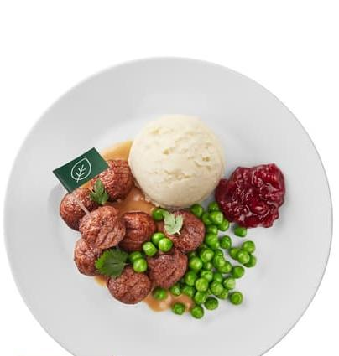
Lunch at IKEA - Main dish
You choose if you want beef, chicken or vegan
Plantbullar (plant-based balls)
✅ Vegan
✅ Gluten-free, ✅ Lactose-free
✅ Halal

Slide 58
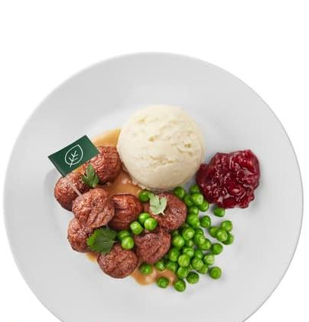
Lunch at IKEA - Sauces
You choose if which sauce you want
Gräddsås (Cream sauce – order with food)
✅ Vegetarian, ✅ Gluten-free
❌ Vegan, ❌ Lactose-free
⚪ Halal ingredients (not certified)
Lingonsås (Lingonberry sauce – available by drinks)
✅ Vegetarian ✅ Vegan
✅ Gluten-free, ✅ Lactose-free
✅ Halal

Slide 59

Lunch at IKEA – Side dish
You choose if you want fries, mashed or cooked potatoes
Pommes (french fries)
✅ Gluten-free, ✅ Lactose-free
✅ Vegetarian/Vegan
Potatismos (mashed potatoes)
✅ Gluten-free
❌Lactose-free
✅ Vegetarian ❌ Vegan
Koktpotatis (boiled potatoes)
✅ Vegan
✅ Gluten-free, ✅ Lactose-free

Slide 60
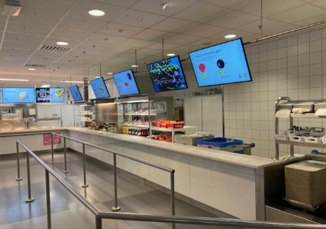
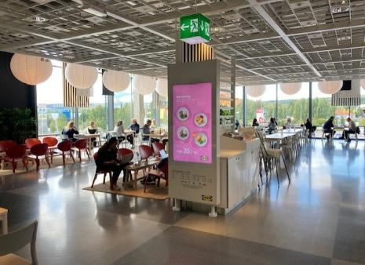
Lunch at IKEA:
Help the food service go fast so everyone can eat.
🍽️ 8 balls + 1 potato option + 1 drink → only take what’s included!
➡️ Queue (right side – own queue for DU) 🧾 Let cashier see what you ordered. ➕ Extras = go to regular line (left side) When finished, throw away paper trash, leave leftover food on the plate, and put your tray on the conveyor belt.

Slide 61
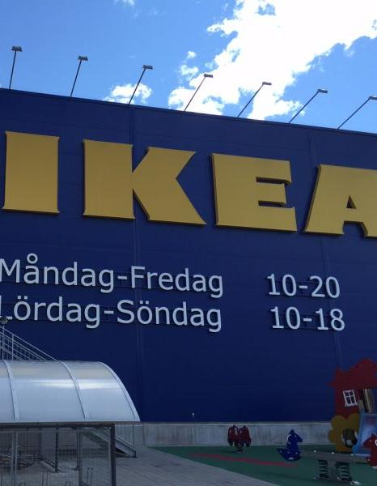
Before we leave
Help the food service go fast so everyone can eat.
15 min walk to IKEA
🚻 Bathrooms: to the left of room B101
👟 You can walk to IKEA right away
👥 Or wait — someone will walk together with you
⏰ Be back on campus by 13:25
🕧 Walk back together at 13:10 (Meet outside IKEA, optional)

Slide 62
Afternoon program
13:30-14:30 Mini fair outside B101(wifi help, campus tours, help with courses, sign up for student union membership)
13:30-16:00 Keycards photographs at the reception (only if you already have an appointent)
14:30-15:00 Feedback and Fika at the staircase of knowledge
15:00-15:30 Additional campus tours

